Slide 1
Applied Behavior Analysis
Michael M. Mueller, Ph.D., BCBA-D, IBA
Executive Director of the International Behavior Analysis Organization (IBAO)

Slide 2
My Background
Practicing in ABA 25 years
BCBA 22 years ago
2005 Southern Behavioral Group
2009 Stimulus Publications
2020 International Behavior Analysis Organization (IBAO)
Importance of certifications for community and providers

Slide 3
What is Applied Behavior Analysis (ABA)?
Behavior Analysis
The study of behavior for its own right – simply to understand what affects behavior in various ways
Not relating to the improvement of any social conditions
Referred to as “Basic” research
Led to the understanding of certain key concepts in behavioral theory
Discriminative Stimuli
Motivating Operations
Reinforcement
Punishment
Extinction
Animal and Human studies

Slide 4
What is Applied Behavior Analysis (ABA)?
Applied Behavior Analysis
The application of “Basic” behavioral principles to problems of social significance
“Social significance” refers to issues that positively impact people
People of all ages. People in all settings and walks of life. In society in general
Because we know what make behavior increase or decrease, we can increase behaviors we want to see more of and decrease behavior we want to see less of

Slide 5
The General Approach to Behavior Change
Since the 1930/40s, we have known about the concepts of Positive Reinforcement
If a behavior is followed by something pleasant, that behavior is likely to occur again in the same situation
Behaviors that do not led to these pleasant consequences are not likely to be repeated
A girl says “cookie” and is given a cookie. When she wants a cookie, she will be more likely to say “Cookie”
Behavior change is based on the consequences of the behavior

Slide 6
The General Approach to Behavior Change
Since the 1930/40s, we have known about the concepts of Negative Reinforcement
If a behavior removes something unpleasant, that behavior is likely to occur again in the same situation
Behaviors that do not led to this removal are not repeated
Someone is too hot. They press the “On” button on the A/C and the hot feeling goes away. Next time they are too hot, they will again press the “On” button
Behavior is changed based its consequences

Slide 7
The General Approach to Behavior Change
If a behavior has been reinforced and then reinforcement is withheld, the behavior will stop too
Extinction
These are reliable and predicable findings through 50 years of research across dozens of species and humans.
In the late 1960s, researchers decided to apply these concepts and techniques to real world concerns.
The concern 50 years ago, as it is today, is to use this science to help to make the world a better place!

Slide 8
Problems of Social Significance
Work production in organizations
Occupational safety
Psychological and mental health issues
Academic achievement
Life skills/Functional skills/Skills of daily living
Social skills
Making friends
Speech and Language
Feeding and eating issues
Sports
Challenging behavior

Slide 9
Autism
Even though ABA has impact on all facets of life, ABA has long been associated with the treatment of issues related to learners with Autism
As Autism Spectrum Disorder is defined by behavioral characteristics:
Language issues
Social issues
Behavioral challenges
ABA is a natural fit as an evidenced based approach to change behavior.
ASD is behavioral excesses and deficits
ABA can reduce and increase behavior

Slide 10
In General, How does it Work?
Skill Acquisition
We know that when reinforcement follows correct responding, it will increase those responses
Conduct a preference assessment to find reinforcers
Conduct a skills assessment
Language, communication, concepts, social skills, play, functional skills, safety, academics, etc.
Determine what skills are in deficit and a priority for learning
Break skills into smaller steps
Hand washing
Turn on water, wet hands, pump soap, scrub hands, rinse, turn off water, etc.

Slide 11
Skill Acquisition
The Behavioral Therapist (IBT) presents an instruction
Correct responses are followed by reinforcement
Incorrect responses are followed by teaching
Prompts, assistance, guidance and the re-delivery of the instruction
Little fragments of larger behaviors can be learned rather quickly, and they add to each other and the learner masters larger skills
The ABA approach relies on the collection of data in order to analyze progress
Data
Graphs
Analysis
Continue or make changes?

Slide 12
Skill Acquisition
Most ABA instructional strategies teach skills in “discrete” learning opportunities referred to as “trials”
Each trial is an opportunity to demonstrate the appropriate skill being taught
Data collection in this context often looks at the number of trials that the correct skill was demonstrated relative to the total number of trials where that skill was taught
Correct trials/total trials = % of correct trials
Develop mastery criteria
Asks, “What will the learner need to do to convince us this skill was mastered?”
%, days or sessions, people, setting

Slide 13
Skill Acquisition
Graph and analyze the data on a day-to-day basis
Increasing trend, flat, decreasing, etc.
Increasing trend means the learner is acquiring the skill (learning)
Flat trend means the learner is not acquiring the skill (not learning)
Decreasing trend means the learner is demonstrating less of a behavior
This is good news in behavior reduction
Not so good if we are trying to teach a new skills

Slide 14
Data Examples

Slide 15
Data Examples

Slide 16
Data Examples

Slide 17
Data Examples

Slide 19
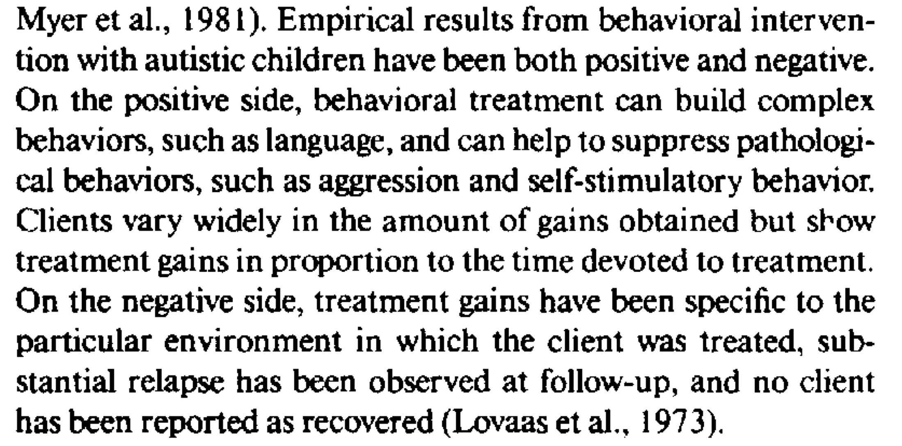

Slide 21
Lovaas et al (1987) results
40 hours ABA Group (n=19)
9 went from below average IQ to average or above average (M – 107, range 94-120).
Those 9 entered 1st grade in general education classes
8 completed 1st grade in “aphasia” classes and IQ in the mild range (M = 70, range 56-95)
2 were in 1st grade in classes for children with ID/autism and IQs less than (<30)
So…. About half of the intense group saw maximum benefit

Slide 22
All participants started the same 30-point increase in IQ ABA group to Control 1 and 2 9 kids in general ed in ABA group (9/19) 1 kid in general ed from both control groups (1/40)

Slide 24
Skill Acquisition
Beyond our ability to change thousands of skills in every category of learning that exists
ABA can increase IQ
Improve school placement and classroom choice
Living options
Academics
Independence

Slide 25
Behavior Reduction
ABA can increase and decrease behavior.
When disruptive, interfering, or dangerous behaviors are demonstrated, ABA can reduce those behaviors which prevents them from interfering with learning
In ASD and other developmental disabilities, minor behavioral issues are present in up to 80% of the population
Mild behaviors
Non-compliance
Vocal and motor stereotypy
Mouthing
Talking in class

Slide 26
Behavior Reduction
In ASD and other developmental disabilities, severe behavioral issues are present in about 45% of the population
Severe behaviors
Self Injury
Self biting, head banging, skin picking, head hitting, etc.
Aggression
Hitting, kicking, biting, pulling hair, etc.
Pica
Elopement
These destructive behaviors happen in all settings
Schools
Home
Community

Slide 27
The General Approach
Since the early 1980s, the field has adopted a “Functional” approach to behavior reduction
Determine the reinforcer for a behavior (the “function”)
Topography is not a big consideration
We do not treat kicking, or hitting, or biting , etc.
We treat behaviors reinforced by certain things the same way
Hitting or biting reinforced by access to preferred items are treated the same
Hitting or biting reinforced by escaping academics is treated differently than those same behavior reinforced by access
It is the function/reinforcer, not the topography that’s important

Slide 28
The General Approach
Determine the function (the reinforcer)
Use the reinforcer in a treatment
Reinforce an appropriate behavior that leads to the same reinforcer
“Replacement behaviors”
Functional Communication Training (FCT)
Differential Reinforcement arrangements (DRO, DRI, DRA)
Non-contingent Reinforcement (NCR)
None of these are prescribed. Any and all can work effectively. The choice is made by the IBA.

Slide 29
ABA is Considered Best Practice
US Surgeon General
American Psychological Association
American Psychiatric Association
Centers for Disease Control and Prevention (CDC)
Autism Speaks
Autism Society of America
National Autism Center
National Institutes of Mental Health

Slide 30
ABA is Considered Best Practice
Every insurance company in the US-- in every state, mandates coverage for ABA services
Federal funding for ABA in ASD treatment
State-level government funding in all 50 states mandatory for ASD services
“Medicaid”
The US Federal Law REQUIRES ABA to be used in public schools
Individuals with Disabilities Education Act (IDEA)
US Federal Law requires the use of the functional approach to behavioral assessment
Thousands of peer-reviewed research articles

Slide 31
Through the lifespan… and everywhere…
ABA is effective from early intervention (0-3) through older adults (65+)
Direct services
IBAs supervise IBTs, parents, teaching Staff
Consultation
IBAs consult with and train parents, teaching staff, rehabilitative staff, etc.
Homes, Centers, Community, Hospitals, Schools, Vocational preparation, Rehab and hospital facilities,

Slide 32
More to come…
Thank you for being here and learning about the approach
This was just a brief and very small over view
For more specific ABA topics and applications, please continue to attend the other presentations. Mine include:
Behavioral Assessment
Behavioral Treatments for challenging behavior
Functional Living Skills

Slide 33
Thanks!
Questions?
mmueller@theIBAO.com

