Slide 1
The Assessment of Functional Living Skills
Michael M Mueller, Ph.D., BCBA-D, IBA

Slide 2
Creating Skill Programs in Schools
For learners with ASD and other DD
Support Team should rely on good assessment data
For most children with ASD a developmental assessment is typically used
Focus is on:
Early language skills
Developmental approach to language acquisition
Early conceptual skills

Slide 3
Early Developmental/Language Assessments
ABLLS-R
Assessment of Basic Language and Learning Skills
VB-MAPP
Verbal Behavior Milestones Assessment and Placement Program
Most recently, PEAK
All encompass the same early learning skills
ABLLS is the most popular and has been used for 20 years

Slide 4
ABLLS-R
Young children with autism/DD
Early language skills
Basics requests
Naming common items
Early developmental sequences
Imitation
Play
Early learning concepts
Academic concepts
Sorting, etc.

Slide 5
ABLLS-R
Very Basic Self-Help Skills
Dressing
Fasteners, putting on and taking off clothes
Eating
Utensils, napkins, drinking from cups
Grooming
Wash/dry hands, brush hair/teeth, blow nose
Toileting
Stay dry, request, urine, bowel

Slide 7
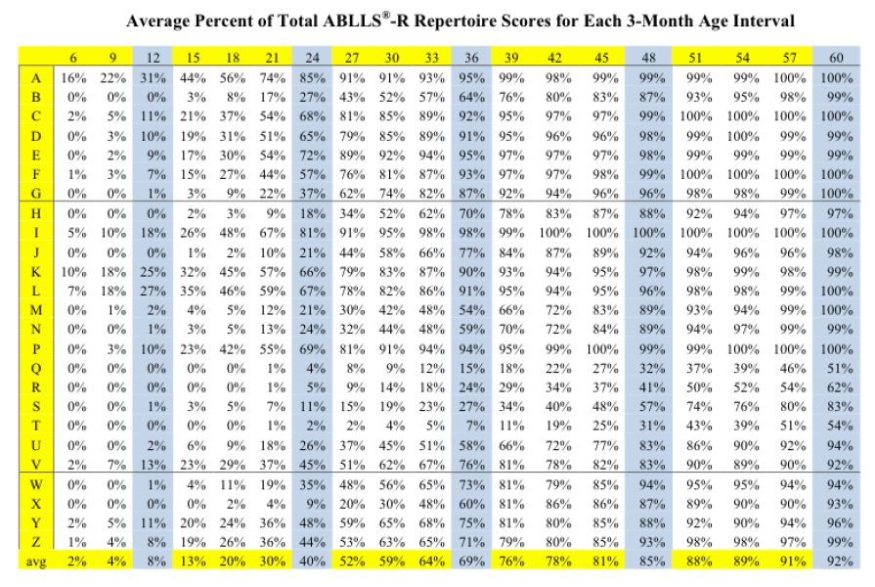
Coop & Reinf Effect
Visual Performance
Receptive Language
Motor Imitation
Vocal Imitation
Requests
Labeling
Intraverbals
Spontaneous Vocalizations
Syntax and Grammar
Play and Leisure
Social Interaction
Group Instruction
Classroom Routines
Generalized Responding
Reading
Math
Writing
Spelling
Dressing
Eating
Grooming
Toileting
Fine Motor
Gross Motor
Notes:
A- SR+ effect, B- vis perfm, C- Rec Lang, D-Mot IM, E-Voc IM, F-Reqest, G- Label, H- Interverb, I- Spont voc, J- synx gram, K- play/leis, L- soc interact, M- grp instruc, N-class rout, P-gen respond, Q- read. R- math, S- writing, T-spell, U- dress, V- eat, W- groom, X-toilet, Y fine mot, Z gross mot

Slide 8
Over Reliance?
22 year old male (Moderate ID, very limited verbal)
About to graduate from high school
Letter sounds, shape sorter, sorting colors, IDMTS
19 year old female (Moderate ID, some device requests)
In a private “ABA School”
Touch baby, roll car, stack blocks, color circle
17 year old (Mod ID, CP, very limited verbal)
Entering high school
Coloring shapes, letter names, item to picture MTS

Slide 9
Reality of Language Development
Language at the end of preschool (4 years old) is strongest predictor of spoken language later in life
Paul, Chawarska, Cicchetti, and Volkmar (2008)
Pickett et al. 2009
Reviewed ALL the existing data through 2008
Only 167 cases were found in which language was acquired by nonverbal children after the age of 5 if it had not been developed prior to 5
None were found above 13 and most (6-12) were close to 6
As of 2015, 3.5 million Americans have some ASD
Some communication is always possible, for learner’s at ALL ages

Slide 10
Communication
If a learner is young
Spoken Language should be a priority and main focus of intervention
Communication should always be a priority and focus
But not to the exclusion of life skills and preparing a child for independence
There IS a time in which the developmental sequence to language will not be acquired
Teaching other skills is more productive

Slide 11
General Outcomes for Learners with ASD
If IQ is below 70 (VIQ and NVIQ) at age 2, 85% of the time, it will be below 70 when learner is 19
VIQ alone, if less than 70, was less than 70 at 19 for 91%
If IQ is higher than 70 at 2 years, outcome is variable with 20% overcoming core autism deficits and testing in the average range of IQ scores at 19
For this group, EIBI was main variable leading to predicting outcomes
Anderson, Liang, Lord (2014)

Slide 13
“DLS Deficit” in ASD
Duncan and Bishop (2013)
Adolescents aged 10-17 57% had DLS Deficit – DLS score significantly lower than FSIQ
In the adolescents who had FSIQ at or above 85, DLS were below 70
Farley et al. (2009)
Adolescents with ASD, IQs in average range (M=86), DLS significantly lower (M=76)
Howlin et al. (2000)
Two groups of adolescents, 1 ASD, 1 Language Disorder
VIQ and NVIQ average and same across groups
DLS for ASD (M=65) DLS for LangDis (M=99)

Slide 14
DLS Deficit in ASD
Smith et al (2012)
Compared groups of young adults (early and mid 20s) with ASD and Down Syndrome
Each group showed progression of DLS skills into early 20s
ASD group – slowed and plateaued whereas Down’s group did not Down’s group progressed throughout lifespan

Slide 15
Daily Living Skill Outcomes
Hus Bal, Kim, Cheong, and Lord (2015)
Longitudinal study: followed kids from 2 years old to 21 years old
All had ASD
Two distinct groups emerged
High DLS/ Low DLS
Higher nonverbal problem solving skills at 2 years led to higher DLS at 21
Higher receptive language at 2 led to higher DLS at 21
ASD compared to non-ASD group of same IQ, ASD group had lower DLS

Slide 16
Hus Bal et al. 2015
At 21
Low DLS group had reached 5 years of DLS
High group reached 14 years of DLS
For Low DLS group, decline in skills from 18 years to 21 years in DLS scores

Slide 18
Hus Bal et al. 2015
Factors influencing the High DLS groups
NVMA (NVIQ)
Receiving 20 hours a week or more of parent implemented intervention
Authors suggest daily living skills be focus of intervention especially for adolescents
“…interventions targeting DLS would benefit young children, regardless of diagnosis”

Slide 19
Duncan, Little, & Stark (2021)
250,000 in US High school every year
50,000 graduate high school each year
At least 50% of individuals with ASD do not have a comorbid intellectual disability (Centers for Disease Control & Prevention,2014)
Lower rates of participation in vocational and educational activities after graduating high school, even when compared to those with ASD and a comorbid ID (Shattuck et al., 2012)
College graduation are lower for those with ASD as compared to those with typical development (Roux et al., 2015)
55% of young adults with ASD were employed, which was significantly lower when compared to other young adults with intellectual and developmental disabilities (Shattuck et al., 2012)

Slide 20
Duncan, Little, & Stark (2021)
Approximately 50% of adults with ASD without ID are living with their parents and require significant supports with everyday activities (Magiati et al., 2014).
These adolescents may be doing well in areas such as academics, they do not have the life skills to allow them to truly thrive in the in the real world
While core deficits are social, communication, and behavior, DLS is also significantly below chronological age (Duncan & Bishop, 2015; Kanne et al., 2011)
DLS required for everyday independence at home, school, and in the community and are typically acquired by certain ages throughout one’s development
most 2–3-year-olds learn to dress and feed themselves
most 8–10-year-olds are able to bathe themselves independently
Adolescents with ASD with average or above average cognitive abilities may have DLS that are 6 to 8 years or more below their age (Duncan & Bishop, 2015; Kanne et al.,2011).

Slide 21
Duncan, Little, & Stark (2021)
Several studies have identified DLS as a predictor of a more positive and successful adult outcome for adolescents with ASD (Clarke et al., 2020; Farley et al., 2009; Klinger et al., 2015; Smith et al., 2012; Taylor & Mailick, 2014).
Those who had higher DLS were more likely to pursue postsecondary education and be employed (Clarke et al., 2020)
These poor outcomes in adulthood are both unexpected and sobering because parents and professionals often expect adolescents with ASD without ID to make a successful and seamless transition to the adult world because of their intact cognitive abilities.
There are a range of evidence-based strategies that have been identified for targeting adaptive behavior, including DLS, in adolescents with ASD utilizing various behavioral strategies
(e.g., direct instruction, reinforcement, chaining, task analysis, prompting) and technology, visual supports, and video modeling (Bennett &Dukes, 2014; Flynn & Healy, 2012; Hume & Reynolds,2010; Matson et al., 2012; Mechling et al., 2009; National Autism Center, 2015; Palmen et al., 2012; Wong et al.,2015).

Slide 22
So… What Does all This Mean?
Need to be aware of the facts related to outcomes and ways we can attempt to change outcomes
There is an overreliance on developmental assessments and curriculum past the point at which many skills can or will likely be achieved
Prioritization for functional communication over spoken language should occur earlier for many learners

Slide 23
So… What Does all This Mean?
DLS Deficits exist in ASD and DD populations, ASD experiences especially poor outcomes
Need earlier inclusion of DLS into EIBI programs because doing so changes outcomes by years
More intervention leads to better outcomes
Earlier intervention leads to better outcomes
Change attitudes about functional skills

Slide 24
Functional Skills
Skills that if the learner does not do, someone will have to do for him
Skills that can be used everyday
Skills that will lead to independence
Skills that are helpful or useful
Skills that allow learner to access different settings

Slide 25
Self-imposed Barriers to Independence
We need to have learner learning to be independent with all skills possible
Let Me Do It For you....
I don’t trust him to .....
He can’t do it by himself
I can do it faster ....
It’s my job as his parent or teacher CAUTION!!!!

Slide 26
Benefits?
Take care of themselves
Help themselves
Self confidence
Improve school placement
Improve living options
Improve vocational options
Decrease need for support personnel
Personal freedom
Perception of others
Social opportunity

Slide 27
When?
When learners are young!
Toileting
Washing hands
Clean and straighten
Basic requests
Cups
Utensils
Dressing
When learners are still getting their skills from early developmental assessments
As soon as possible!
Notes:
Pick out clothes, get dressed, clean up room, help with table, drinking, eating, utensils, manners, asking, waiting, learning routines, streets, steps, curbs, cars, shopping expectations, accepting no, changes, remaining calm, all VERY early skills

Slide 28
So, ages?
4-5 years old range
Basic Living Skills 166 skills
Home Skills 125 skills
Community Participation Skills 133 skills
School Skills 201 skills
625 Skills in the Basic, Home, Community, and School protocols
ABLLS/AFLS is not when to switch.
It is when to add and when to focus on different content from each
They work well together for a reason!

Slide 29
Where to Start Assessing?
Home (with parents)
School
Community
Home (Group homes, apartments, etc.)
Vocational areas

Slide 30
AFLS Development
Assessment of Functional Living Skills
ABLLS-R Structure
Scoring
Skills Tracking Grid
Different Assessment Protocols
Create Unique Assessments based on your needs and your learner’s situation

Slide 32
AFLS - History
SBG, school and home behavioral consultation
Preach the model of assess and then develop IEP goals and objectives
Older learners? Now what…
Nothing to use that I liked
Originally conceptualized the AFLS as a follow up to the ABLLS
What to use when someone has mastered the ABLLS
What to use when someone hasn’t

Slide 33
AFLS…
Very unique in different ways
1900 skills and every item’s scoring criteria are unique
Only assessment with multiple protocols
6 Different stand-alone assessments
Mix and match
Not required to complete any protocols in any order

Slide 34
Uniqueness
“Doing the AFLS” can mean a LOT of different things
6 different stand alone
15 different 2-protocol pairings
20 different 3-protocol combinations
15 different 4-protocol combinations
6 different 5-book combinations
This is 56 different protocol combinations that can all be “Doing the AFLS”

Slide 35
Protocol Combinations
Create the specific combination of protocols to address the needs of a learners and priority of an instructional program
You use the protocols that correspond to where you want to teach
You use those that are most relevant
Minimize over-assessing

Slide 36
AFLS… Three Different Aspects
Assessment
Like all assessments, this gives you a snapshot of the learner’s skills at the time of administration
A protocol can be used for 4 separate administrations for a learner
Skills Tracking Grid
Depicts the results visually for easy analysis
Shows progress from administration to administration
Curriculum
Teach skills based on results
Teach subsequent skills in those areas when first skills are mastered

Slide 37
How to Administer
Interview
Interview first
Most information can be gained this way
Parents
Teachers
Other Staff
Caution: Reports from other areas may not reflect learner’s current ability in all areas
Observation
Observe second
Most info will be gained through your first-hand knowledge– through previous observation
School, home, stores, mall, vehicles, peers, family

Slide 38
How to Administer
Directly test*
IF SAFE!!!!!!
Better to err on side of too low than too high
This should be very rare and only if safe!

Slide 39
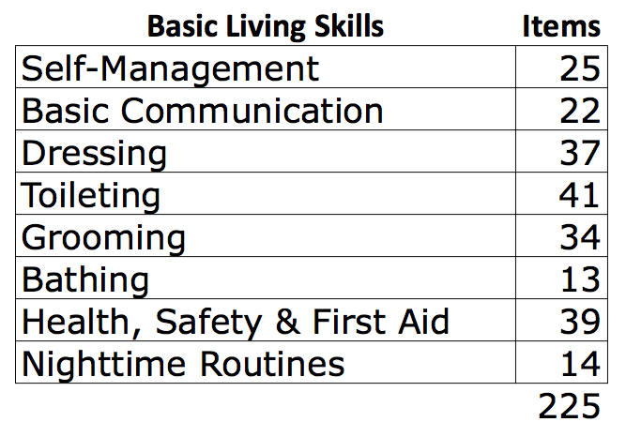

Slide 41
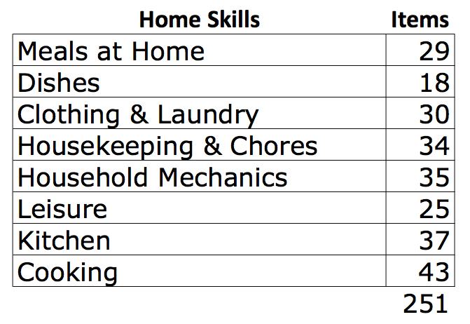

Slide 43
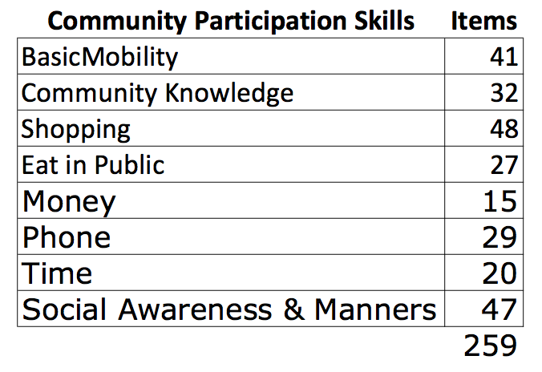

Slide 45
School Skills Protocol | Items
Classroom Mechanics | 18
Meals at School | 34
Routines and Expectations | 46
Social Skills | 35
Technology | 40
Common Knowledge | 51
Core Academics | 51
Applied Academics | 55
330

Slide 47
Independent Living Skills |  | Items
Organizational Skills |  | 23
Self Care |  | 37
Maintenance and Cleaning |  | 36
Mechanics and Repairs |  | 21
Community Travel |  | 26
Transportation |  | 37
Kitchen Tools and Appliances |  | 23
Food and Meal Planning |  | 19
Money Management |  | 30
Independent Shopping |  | 20
Personal Management |  | 30
Safety |  | 34
Problem Solving |  | 19
Social Interactions |  | 29
Living With Others |  | 18
Interpersonal Relationships |  | 34
436

Slide 49
Vocational Skills |  | Items
Job Search |  | 25
Interview |  | 22
Basic Skills |  | 44
Coworker Relations |  | 15
Workplace Safety |  | 35
Fixed Activity Skills |  | 9
Custodial and Cleaning |  | 47
Laundry |  | 14
Retail |  | 22
Support Personnel |  | 6
Office Skills |  | 40
Computer Skills |  | 31
Restaurant Skills |  | 33
Restaurant Kitchen |  | 23
Warehouse |  | 13
Tools |  | 30
Trades and Construction |  | 40
Landscaping |  | 15
464

Slide 50
Summary
Now you know everything there is about the AFLS!
What’s next?
Teach! Teach! Teach!
You know the data of the field and of autism
Get out there and continue to make a difference!

Slide 51
Questions?
mmueller@theIBAO.com

